Slide 1
Increasing SAT Participation Rate in Wisconsin
By Group 5, DSI13
Amanda Lee, Jason Chia, Feng Ruili, Elton Yeo

Slide 2
Context and Problem Statement
The ACT and SAT tests are measures of college readiness and students admission into college.
In the recent years, the ACT participation percentage of 100% > SAT participation.
College Board as a non-profit organisation:
Connect students to college success
Expand access to higher education
Aims to increase participation for the SATs.
One of the lowest participation for SAT: Wisconsin
Lowest participation in both SAT and ACT: Oregon
Notes:
We are a group of Data Scientist from the College Board and would like to present to you our strategy and plan to increase participation rate in Wisconsin.
To give you some context, The ACT and SAT tests are used as a
measure of college readiness and
used as a basis for students admission to college through these tests.
The ACT includes an English Test, Reading Test, Mathematics Test and a Science Test. The SAT includes a Reading Test, Writing and Language Test and a Math Test.
Over the years, the ACTs is more popular in comparison to the SATs.
In recent years, the **ACT has had a higher frequency of full participation (100%) for more states as compared to the participation for the SATs.**
We aim to increase participation for the SATs
With that in mind we did some primary research to find states with lower rates of participation for the tests:
Lowest participation in the SAT alone: Wisconsin (3rd lowest)
We are a non profit organisation with the
goal to connect students to college success
expand access to higher education. With the interest to promote the participation of SATs, we aim to devise a strategic plan that targets areas where lower rates of participation for SAT tests are observed.
Lowest participation in both SAT and ACT: Oregon

Slide 3
Summary of Analysis
Distribution of variables: A visual assessment of histograms of each variable showed that they are multimodal distributions. Running the Shapiro-Wilk test on each variable also showed that except for ACT 2017 reading scores, ACT 2017 science scores, and ACT 2018 science scores, which have p values above 0.05, all other variables do not have normal distributions → unable to draw valid conclusions.
E.g. multiple clusters of states along spectrum of participation rate
ACT vs. SAT: participation rates for SAT and ACT are negatively correlated, implying that students who take one test typically do not take the other.
e.g . Colorado: jump from 11% to 100% after SAT was mandated and corresponding fall in ACT rates.

Slide 4
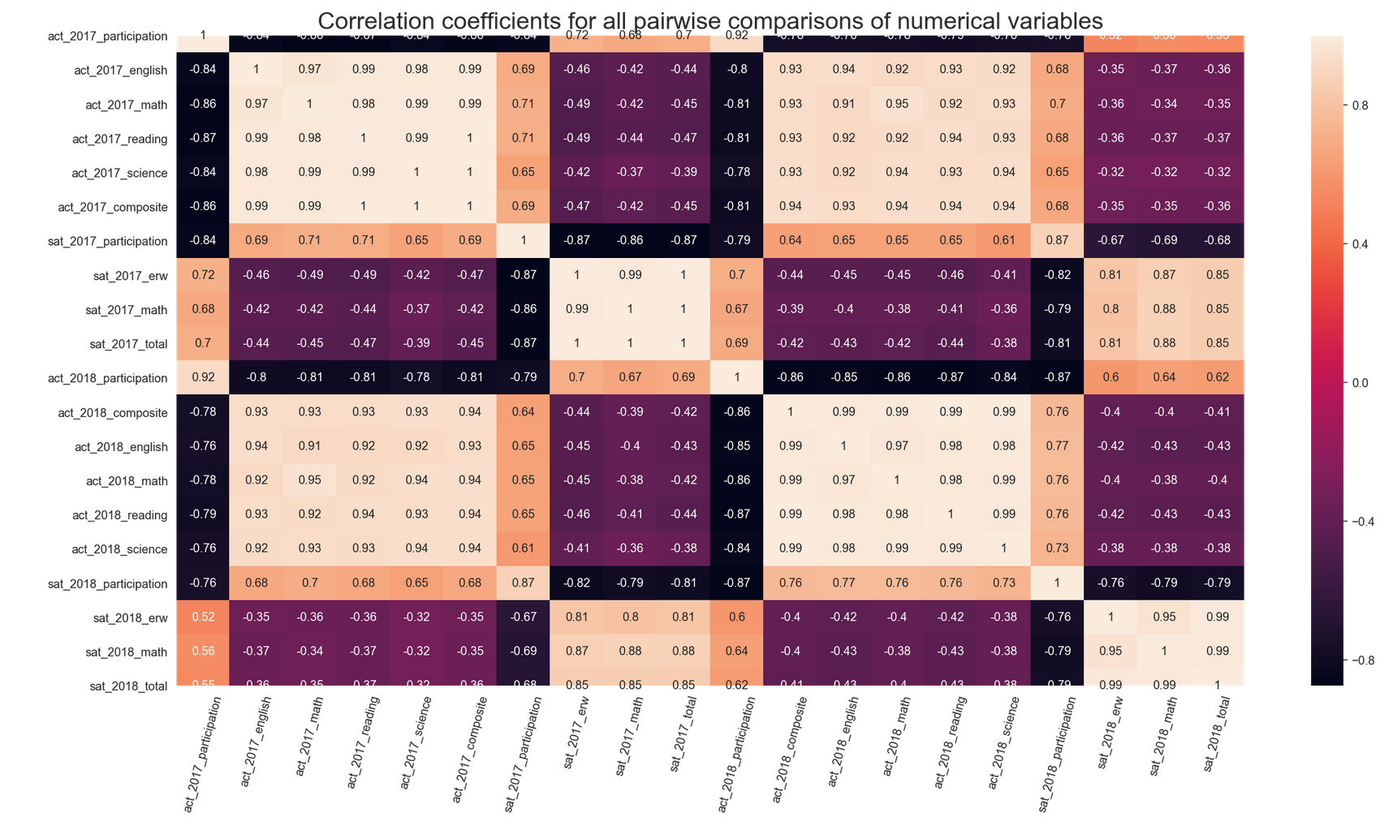
Interpretation of Results

Slide 5
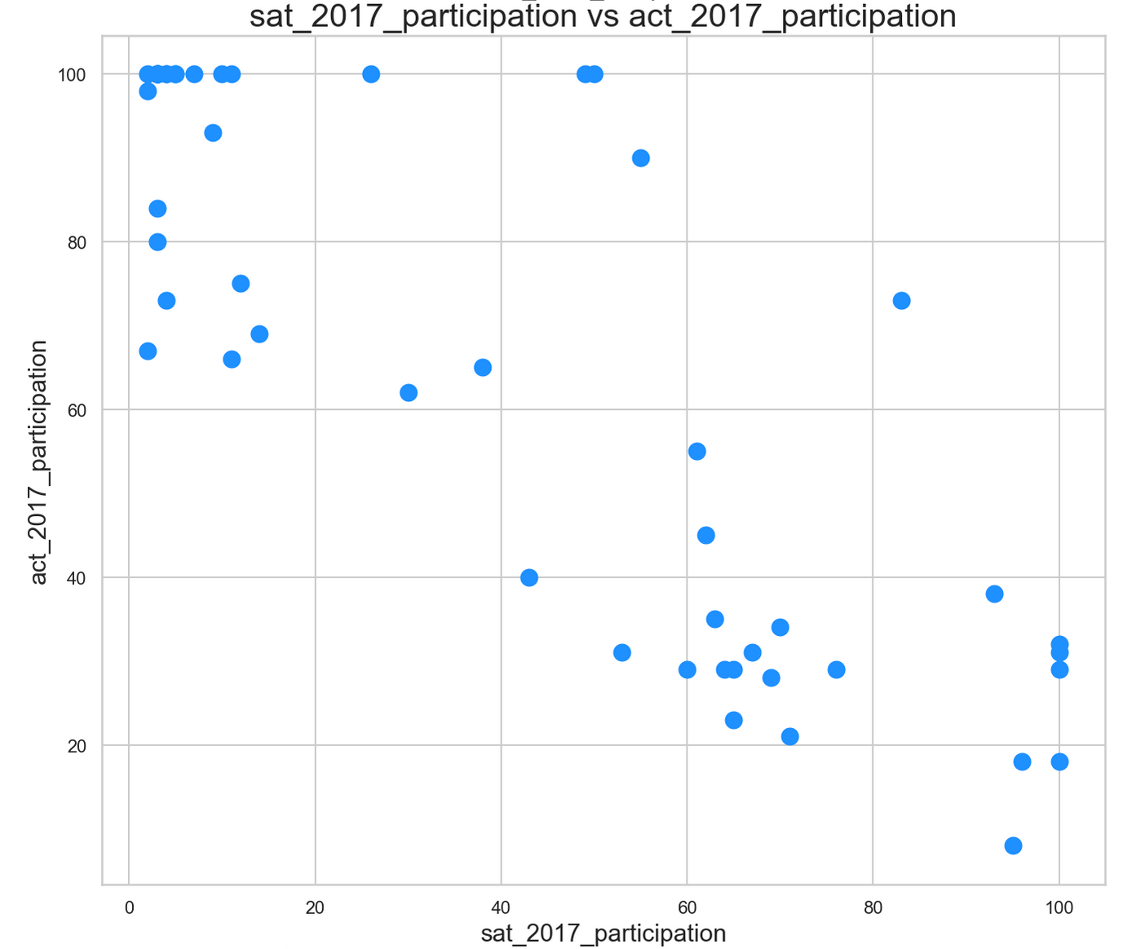
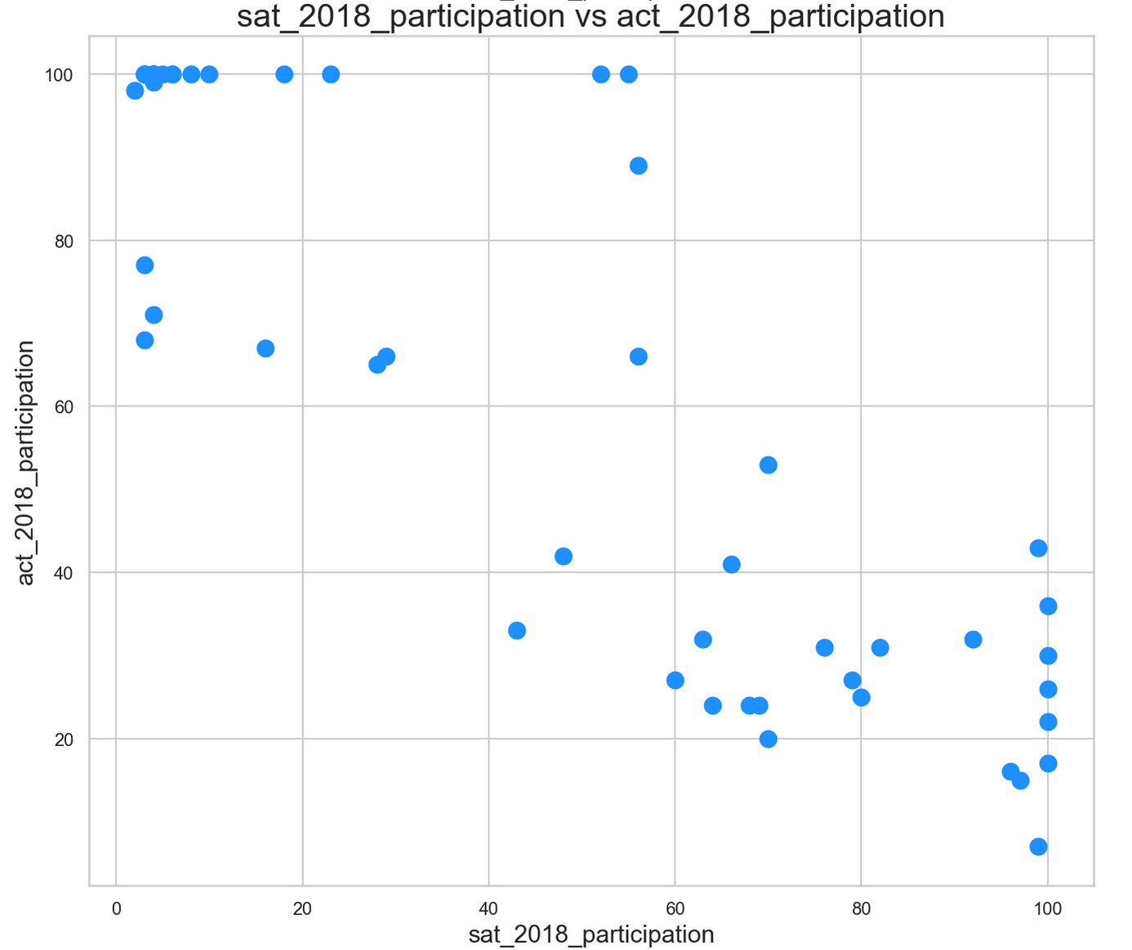
Interpretation of Results

Slide 6
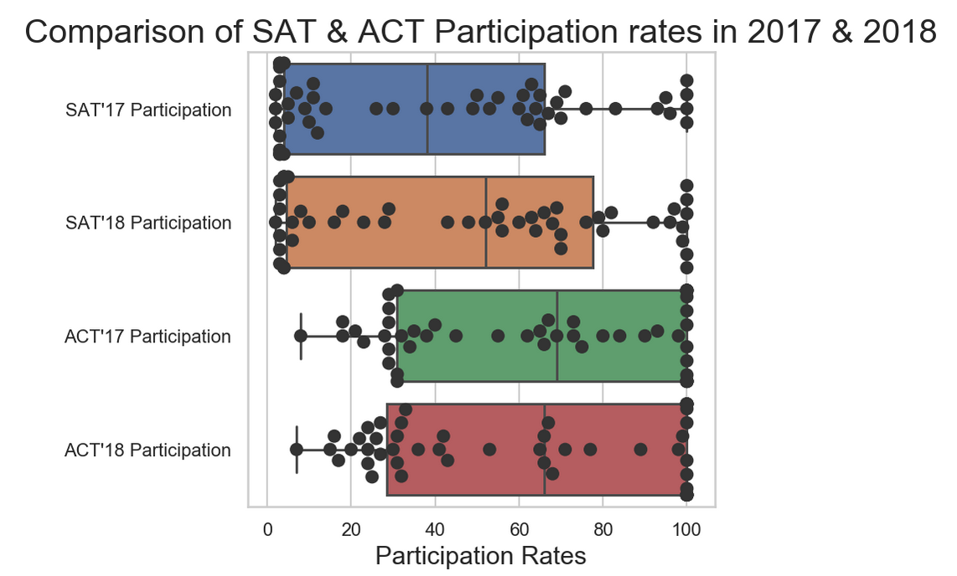
Interpretation of Results

Slide 7
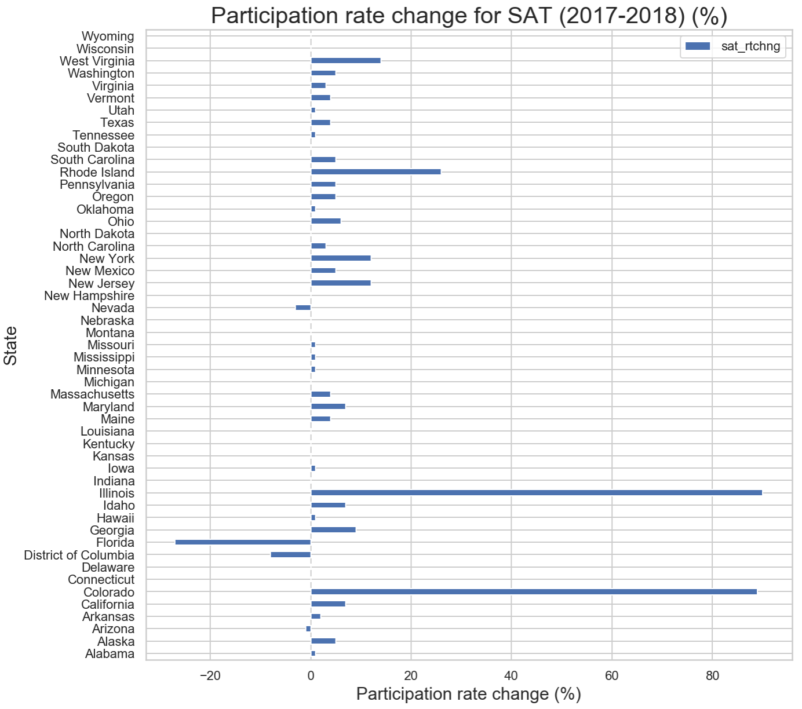
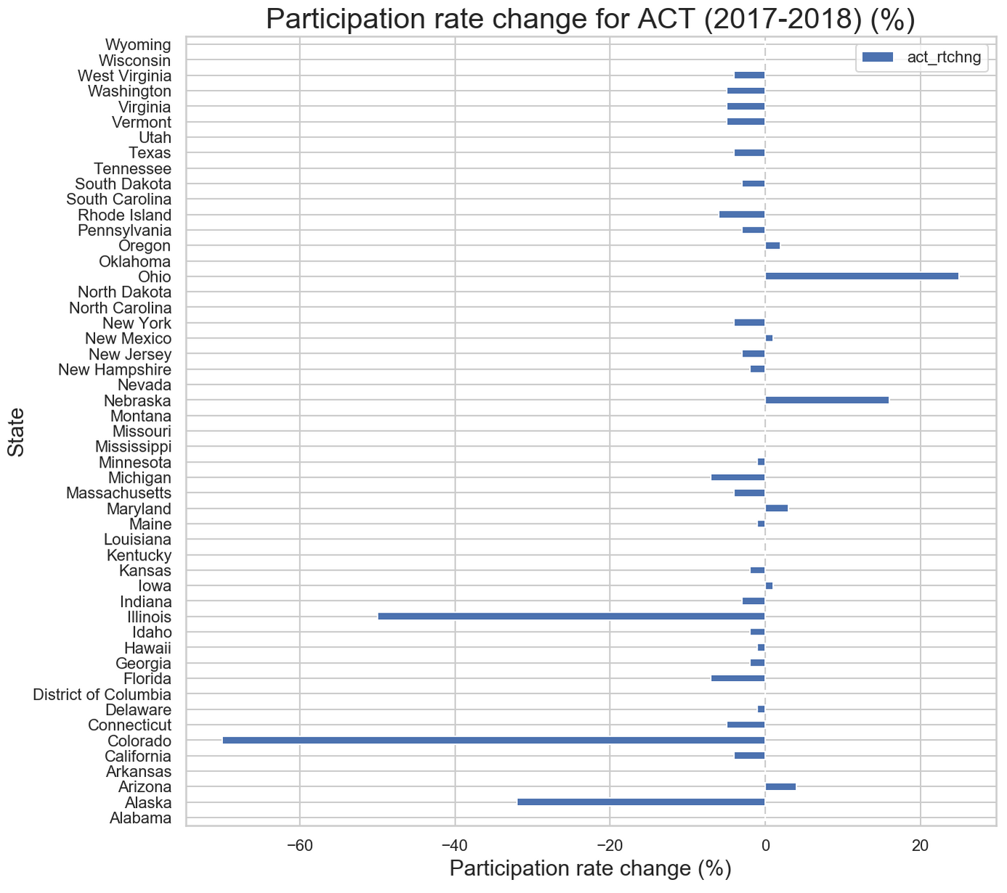
Interpretation of Results

Slide 8
Interpretation of Results
Significant spike in SAT participation rate 2017-2018
Illinois, Colorado, Rhode Island
Illinois State Board of Education has ended its contract with ACT as the College Board earlier won a three-year, $14.3 million bid to give its exam to all public high school juniors in Illinois in 2016
In Colorado, the state Department of Education announced in 2015 that a selection committee chose The College Board, makers of the SAT, over the ACT testing company, through a competitive bidding process
In 2018, the SATs and PSATs became a graduation requirement, part of the Rhode Island’s college admission test
Notes:
Three states (1. Illinois, 2. Colorado and 3. Rhode Island) have demonstrated significant increase in their SAT participation rates from 2017 to 2018. See following for possible reasons:
1) Illinois State Board of Education has ended its contract with ACT as the College Board earlier won a three-year, $14.3 million bid to give its exam to all public high school juniors in Illinois in 2016.(source: https://www.chicagotribune.com/news/ct-illinois-chooses-sat-met-20160211-story.html)
2) In Colorado, the state Department of Education announced in 2015 that a selection committee chose The College Board, makers of the SAT, over the ACT testing company, through a competitive bidding process.(source:https://chalkbeat.org/posts/co/2015/12/23/goodbye-act-hello-sat-a-significant-change-for-colorado-high-schoolers/)
3) In 2018, the SATs and PSATs became a graduation requirement, part of the Rhode Island’s college admission test.(source:https://www.providencejournal.com/news/20181025/with-sat-required-ri-sees-jump-in-participation-decline-in-scores)

Slide 9
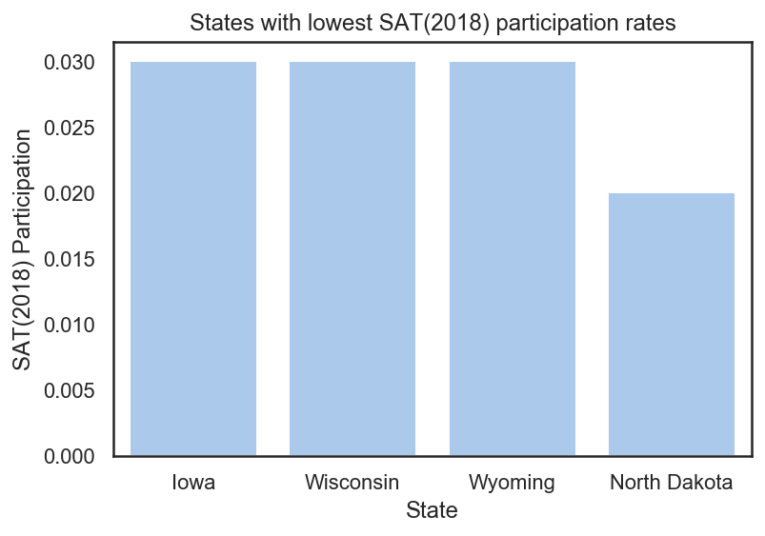
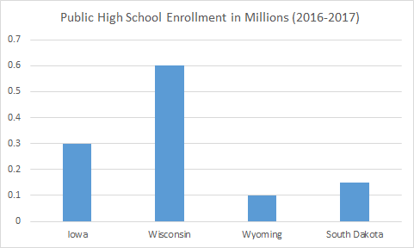
Recommendation - State
Target Wisconsin to achieve significant increase in SAT participation rate
Wisconsin mandates student from public schools to take ACT - potential to achieve 100%
Wisconsin had the third lowest participation rate (0.03) in 2018
Wisconsin's public high school student population was larger than Iowa, North Dakota and Wyoming (source: https://educationdata.org/number-of-public-schools/)
Other possible targets include Oregon which had the lowest combined SAT and ACT participation rates in 2018

Slide 10
Recommendation - Strategy
Win contracts with the Wisconsin Department of Education to make SAT mandatory
Wisconsin state is likely to prioritise cost reduction over the next few years as the US government has only approved a state budget which was half the amount of what was requested by Wisconsin in 2019 (source: https://www.wuwm.com/post/budget-compromise-gives-wisconsin-schools-half-funding-boost-evers-wanted#stream/0)
The College Board can undercut ACT when Wisconsin’s contract with ACT ends and reinvent the success achieved in Colorado and Illinois
Assumptions: Wisconsin’s contract duration with ACT will end in 2020 and Wisconsin will continue to mandate SAT/ACT
Other considerations include offering free SAT to students

Slide 11
Questions?

